Slide 1
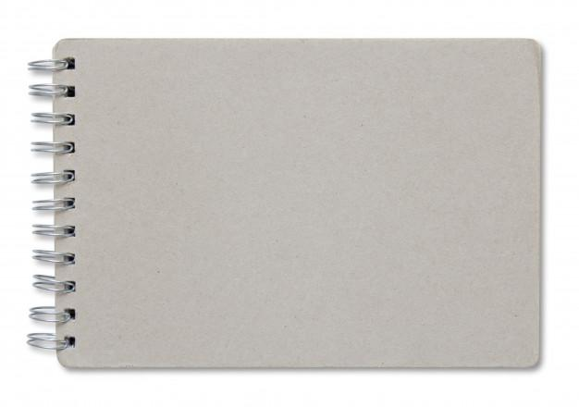


Schoology
Parent Handbook
Link to Schoology
Link to Schoology’s Online Parent Support Platform

Slide 2
Table of Contents
1. Sign up for a parent account
2. Adding multiple children
3. My child’s classes
4. My child’s assignments
5. My child’s grades
6. Updates and Announcements
7. Parent Email Notifications
8. Parent TEXT notifications

Slide 3


Sign up for a parent account
My child’s assignments
Go to www.schoology.com.
Click Sign Up at the top of the page and choose Parent.
Enter your Parent Access Code. This is a 12-digit code in xxxx-xxxx-xxxx format that you receive from one of your child's instructors.
Fill out the form with your information.
Click Register to complete.
Sign up for a parent account
Parent Email Notifications
My child’s
grades
Adding multiple children
Parent Text Notifications
Updates and Announcements
My child’s classes

Slide 4
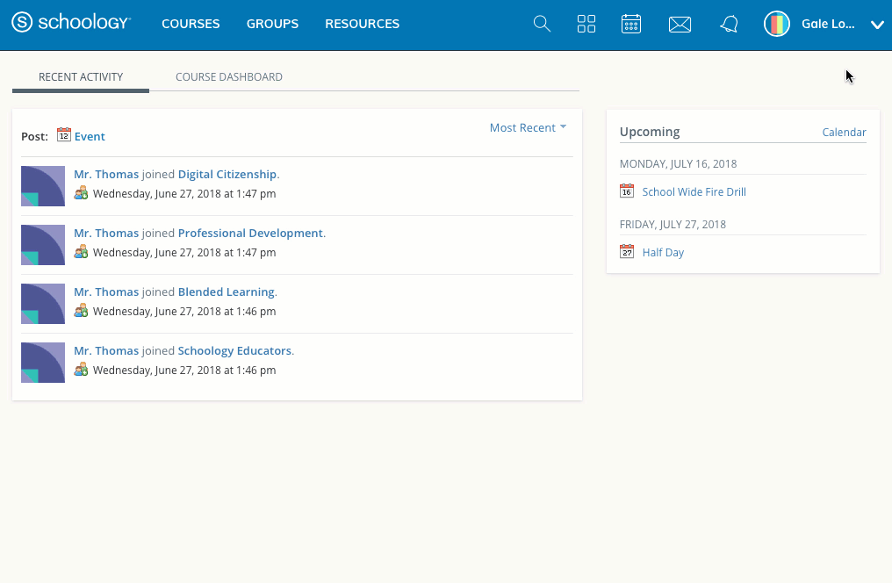
Adding multiple children
My child’s assignments
Log in to your Schoology account using your username or email address and password.
Click the arrow next to your name in the top-right corner.
Click the Add Child button.
Enter the Child Code for the child you're adding. This is the same as your Parent Access Code, the 12-digit code in xxxx-xxxx-xxxx format that you receive from one of your child's instructors.
If your code does not look like this code, contact your child's instructor or school.
Click the Use Code button to complete.
Sign up for a parent account
Parent Email Notifications
My child’s
grades
Adding multiple children
Parent Text Notifications
Updates and Announcements
My child’s classes

Slide 5
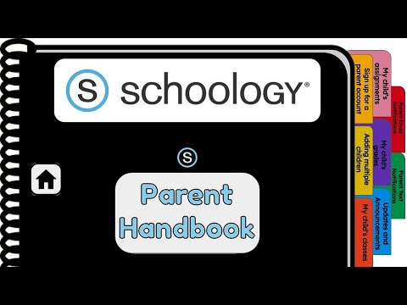
My child’s classes
My child’s assignments
Once signed on, click your profile picture to get access to your students' account. (Message one of your student’s teachers if you need the parent sign-in code.)
Click on your student (or student's) name.
Once in your students' account, you will land on their activity page. You will see a list classes they are currently enrolled in on the left side of the page. Click on the course name to access the course.
You can also view your child’s classes by clicking on “Courses” at the top of their activity page. This will show you a tiled list of all the courses your child is currently enrolled in. Click on the tile to access the course you would like to view. .
Sign up for a parent account
Parent Email Notifications
My child’s
grades
Adding multiple children
Parent Text Notifications
Updates and Announcements
My child’s classes

Slide 6

My child’s assignments
My child’s assignments
Once signed on, click your profile picture to get access to your students' account. (Message one of your student’s teachers if you need the parent sign-in code.)
Click on your student (or student's) name.
Once in your students' account, you will land on their activity page. You will see a list of overdue and upcoming assignments on the right side of this page. Click on the assignments for specific details.
You can also click on the calendar icon to see assignments using a monthly, weekly, or daily view. Place your cursor over the title. A clue tip displays with the event type (assignment, test/quiz), the event's course or group, and the student name. Click the event to display profile information in a pop-up window.
Sign up for a parent account
Parent Email Notifications
My child’s
grades
Adding multiple children
Parent Text Notifications
Updates and Announcements
My child’s classes

Slide 7
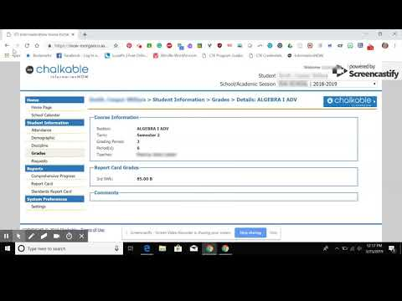
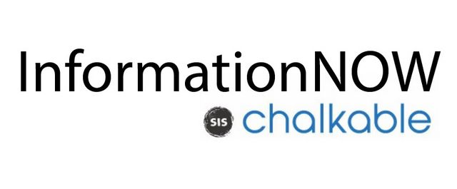

My child’s grades
My child’s assignments
Click the InformationNOW logo below to access the login page.
Once logged on, click grades on the lefthand side.
Ensure the grading period is correct.
You can now review your child’s grades for all courses. Click the course you would like to view grades in. Click on it again to close that course.
Sign up for a parent account
Parent Email Notifications
My child’s
grades
Adding multiple children
Parent Text Notifications
Updates and Announcements
My child’s classes

Slide 8
Updates and Announcements
Once signed on, you will land on the homepage which is where you will find :
On the left side:
  Updates/Announcements from buildings or courses you are enrolled in.
  A list of courses you are enrolled in
  A list of Groups you are enrolled in.
  Resources (Personal or Group)
On the right side:
  Search
  Calendar of events/Assignments
  Email
  Notifications
  Profile picture, name, and more options.
My child’s assignments
Sign up for a parent account
Parent Email Notifications
My child’s
grades
Adding multiple children
Parent Text Notifications
Updates and Announcements
My child’s classes

Slide 9
Parent Email Notifications
Once signed on, click your profile picture to get access to your students' account. (Message one of your student’s teachers if you need the parent sign-in code.)
Click on your student (or student's) name.
Once in your students' account, click their profile picture again and click "settings" at the bottom.
Then click the "notifications" tab on the left.
You can then pick either daily or weekly email summaries. You can also get an email when an item has not been submitted through Schoology by your student.
(NOTE: This only works for assignments that need submissions).
My child’s assignments
Sign up for a parent account
Parent Email Notifications
My child’s
grades
Adding multiple children
Parent Text Notifications
Updates and Announcements
My child’s classes

Slide 10
Parent Text Notifications
My child’s assignments
Sign up for a parent account
Once signed in, click your profile picture to get access to the “settings” link. (Message one of your student’s teachers if you need the parent sign-in code.)
Once in “settings” click the “notifications” tab.
On the right will be a blue box to add your mobile number.
Choose from the list what notifications you want sent to you by email or by text.
Parent Email Notifications
My child’s
grades
Adding multiple children
Parent Text Notifications
Updates and Announcements
My child’s classes

