Slide 1






Schoology Student Notebook
When in doubt EVER on Schoology, click the blue help button to access the searchable user guide.
Linking with Google
Weekly Agendas
Google Assignments
Schoology Assessments
Messaging Teachers
Calendar
Click Here to go to the schoology Website!
Log in with your school account.
Notifications
Grades and Feedback

Slide 2
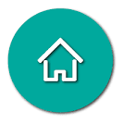

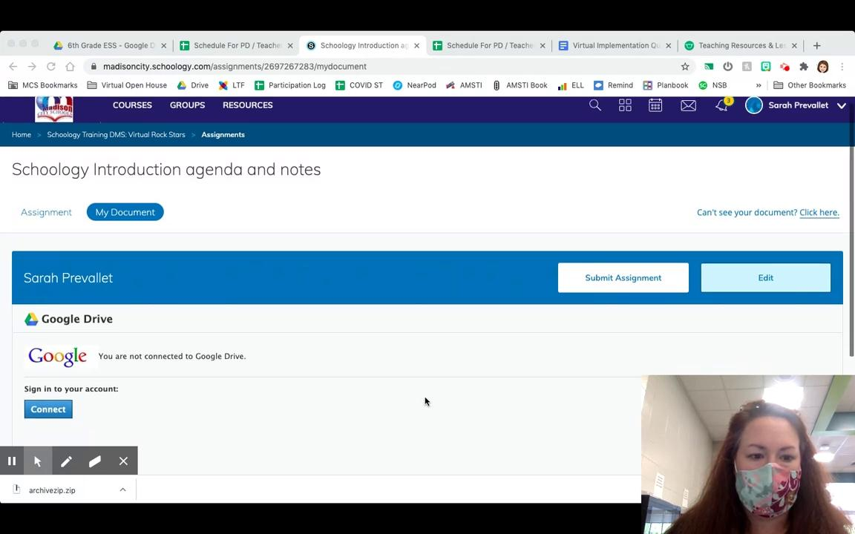
Linking Your Account with Google
There is no sound in this video ;)
Linking with Google
Many assignments you will complete will be via the google suite of tools. Schoology is designed to work with google. You will need to authorize your Madison City Schools schoology and google accounts to talk to one another.
Weekly Agendas
Google Assignments
Schoology Assessments
Messaging Teachers
Calendar
Notifications
Grades and Feedback

Slide 3
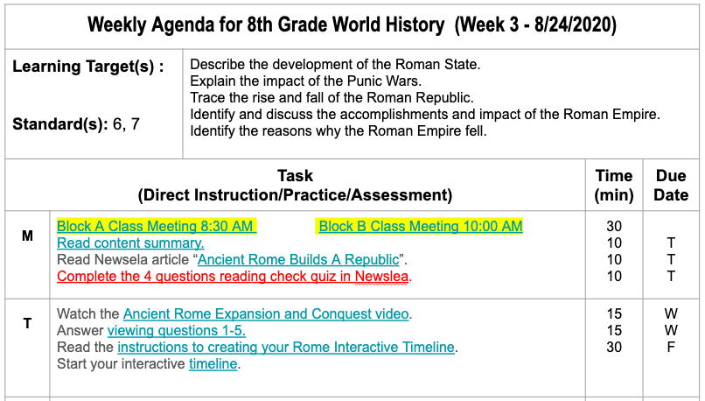
Weekly Agendas
Linking with Google
Every class has a weekly agenda. These will be found on Schoology. Pay close attention to where your teachers have placed these in their virtual Schoology classrooms. The weekly agendas have three major parts that are color coded.
1. Live Meetings (2-3x per week)
2.Activities (about 20-40 mins)
3.Assignments (graded materials)
Weekly Agendas
Google Assignments
Schoology Assessments
Messaging Teachers
Calendar
Notifications
Grades and Feedback

Slide 4
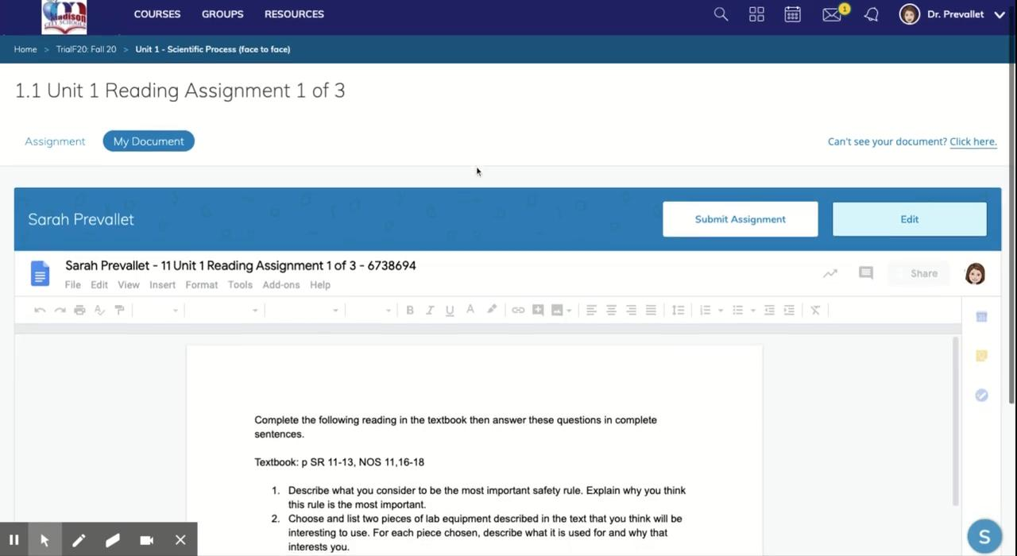

Completing Google Assignments
Linking with Google
Many of your assignments will use the google suite of tools. Each student will be assigned their own copy of a google doc, sheets, slides etc using the schoology assignment tool.
Weekly Agendas
Google Assignments
Schoology Assessments
Messaging Teachers
Calendar
Assignment Icon in Schoology
Notifications
Grades and Feedback

Slide 5
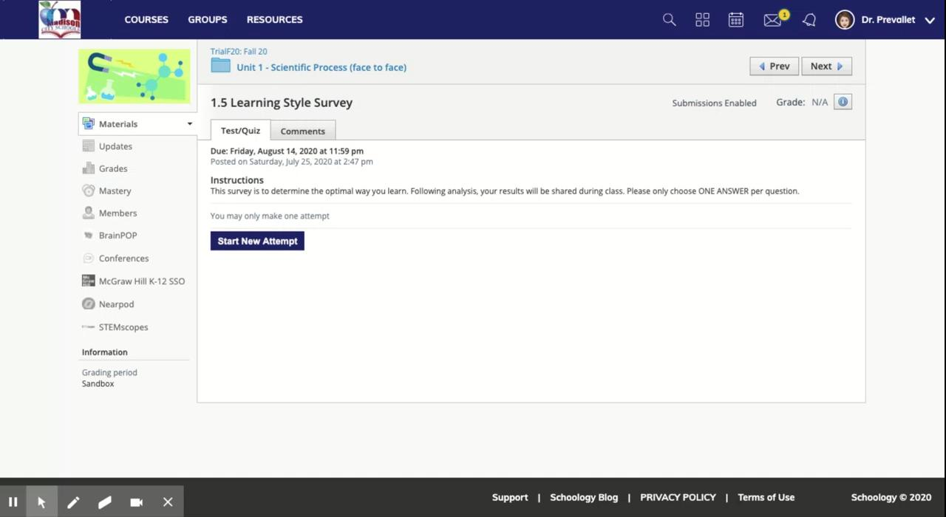


Completing Schoology Assessments
Linking with Google
Schoology has a robust assessment tool your teachers will use to make tests, quizzes, and forms.
Weekly Agendas
Google Assignments
Schoology Assessments
Messaging Teachers
Assessment Icons in Schoology
Calendar
Notifications
Grades and Feedback

Slide 6
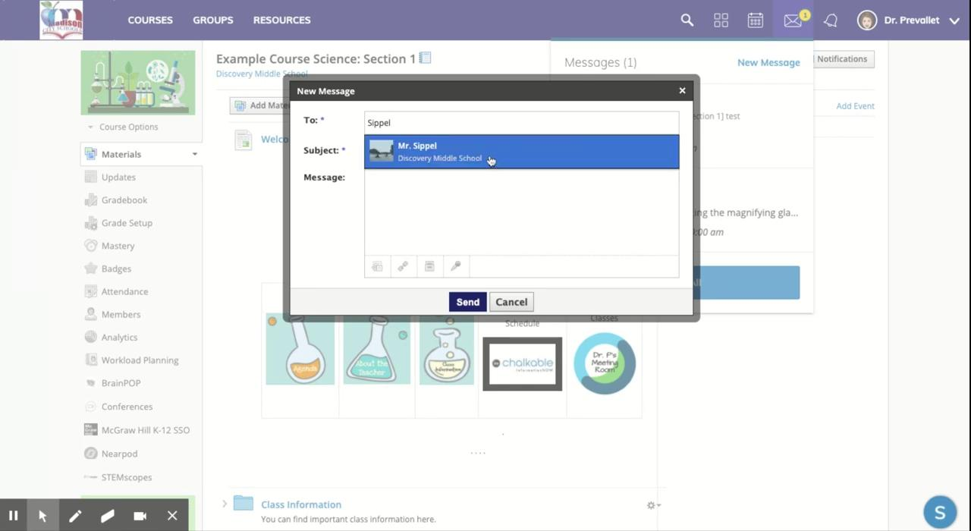
Messaging Teachers
Linking with Google
Schoology has an internal messaging system. Students are strongly encouraged to use this system to communicate with their teachers easily. There is also a great app you can download for your phone as well.
Weekly Agendas
Google Assignments
Schoology Assessments
Messaging Teachers
Calendar
Most things on Schoology can be done in a variety of ways. Anytime you see a teacher’s name you can click on it to send a message as well.
Messenger Icon in the top right corner of your screen.
Notifications
Grades and Feedback

Slide 7
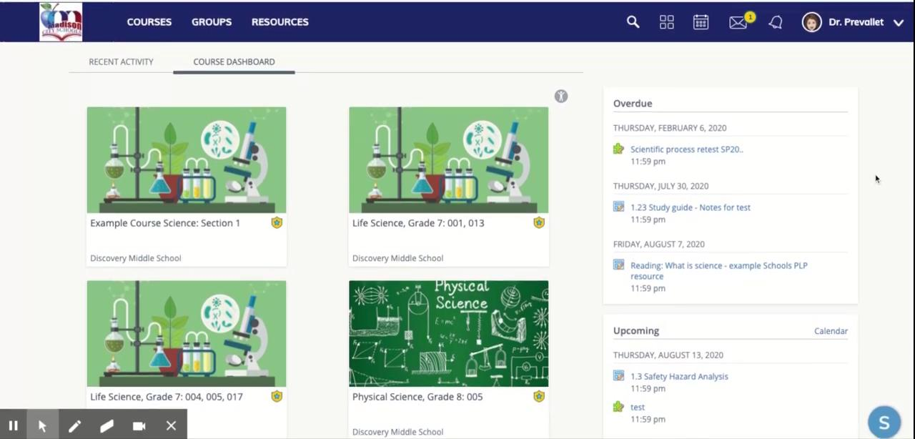
Calendar Features
Linking with Google
To view all of your assessments and assignments from all your classes at once you can use the calendar feature.
Weekly Agendas
Google Assignments
Schoology Assessments
Messaging Teachers
Calendar
Calendar Icon in the top right corner of your screen.
Notifications
Grades and Feedback

Slide 8

Setting Notifications
Linking with Google
Schoology offers a variety of different notification options to keep you automatically updated on the happenings in your courses.
Weekly Agendas
Google Assignments
Schoology Assessments
Messaging Teachers
Calendar
Your preferences are under your name in the top right corner of your screen.
Notifications
Grades and Feedback

Slide 9
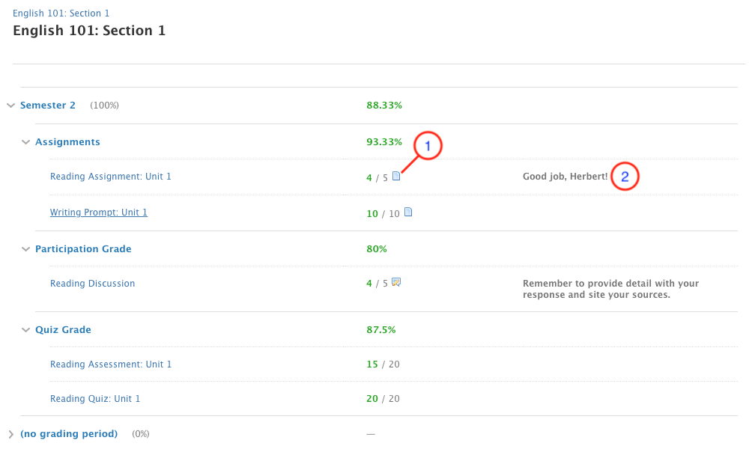
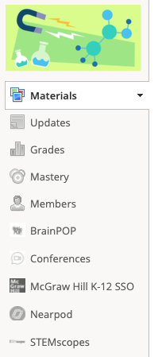
Grades and Feedback
Linking with Google
Teachers can leave comments and grades for you to review. To check how you did on an assignment or read the teacher’s feedback you’ll need to use grades. NOTE: All official grades are in INOW.
Weekly Agendas
Google Assignments
Click grades in the left hand menu to review your work
Schoology Assessments
Messaging Teachers
Calendar
Notifications
Grades and Feedback

Slide 10



There are so many things you can do in schoology!
Ready for master level? Click the icon below to try working on the schoology master level checklist. Each item is linked to the schoology student guide.
Master Level

